Slide 1
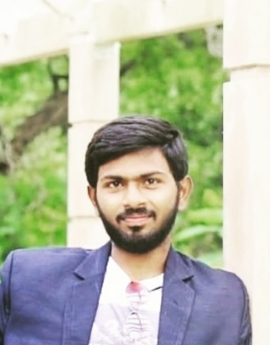
CHAITANYA KRISHNA BURLAGADDA
Education and certificates
Bachelor of Engineering
Civil Engineering : 2017-2021
Analyst/Software Engineer
Skills
Java
OOPs, Collection, Generics, Exception Handling, Annotation
Java 8- Lambda Function, Stream, Functional Interface
JDBC
Backend
Spring Boot/Spring Security
REST-API JPA CRUD
Database
SQL database – SQLPlus, PostgreSQL
No SQL database – MongoDB
Base Location: Mumbai
Email ID: Chaitanya-krishna.burlagadda@capgemini.com
Mobile No: +91 9346188351
Grade: A4
Strength
Open to learn new technologies and ready to
Achivement
Airline Ticket Booking Application
Understood the requirement document for the case study and developed a back end application
Created base project using Spring Tool Suit with
dependencies.
Used PostgreSQL as database. Using REST API done CRUD for vehicle module, booking module and checked with postman.
•
implement them to further improve my knowledge
A team player with good communication and
Web Technologies
HTML5,CSS3
JavaScript React
Tools/IDE IntelliJ IDEA Eclipse
Visual Studio Code Spring Tool Suite
AddOns Github Maven Postman
positive approach
Knowledge of Back End Java ddevelopment using
Spring Boot, JDBC and PostgreSQL
Expense Tracker
Developed a front end application using React JS Library with Visual Studio Code. It helps user to track expenses.
Enhanced user interface using HTML, CSS
•
Understanding of Front End development using HTML,CSS,JS and React JS
Additional Details Leadership Skills Self Learner
Check out my work on GitHub

